Slide 1
Host quality simulation

Slide 2
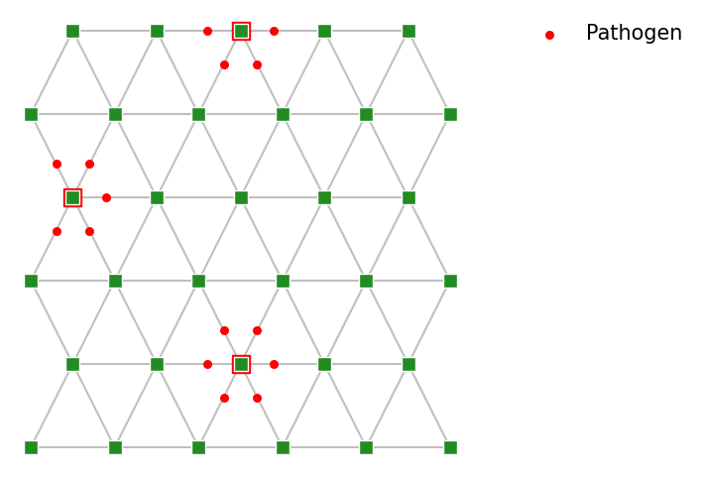
Variations in:
[exposure]: number of neighboring plants
Exposure = encountering the pathogen in your own realm (going to the pub during covid)
[establishment]: threshold for disease for each plant
[growth]: maximal number of pathogen particles the host spreads, reservoir size
[infectivity]: speed at which pathogen can move from plant, hoeveel eruit gaat

Slide 3
Read Tara Stewart Merrill papers (& more)
Make a short summary for non-modellers
In host quality context
Michelle Hersch has data
Big DIGDEEP meeting: prepare 15 min presentation
Two critical questions to address

